Slide 1
Solution Architecture Canvas
Chicago DMC

Slide 2
Solution Architecture Canvas - <Name of Project>
Vision/Business Objectives:
Key Business Scenarios (MVP): A B |  | Metrics/KPIs to Capture - Identify the Business Value Metrics to Captured by the Solution | Data Integrations & Data Sources: Data Sources used, Systems integrated with for retrieving/updating data Identify any data sources/needs that would be impacted by GDPR
Key Capabilities Impacted This is typically categorized as business applications, services, information stores, technology infrastructure, etc., and it can also indicate which of the components are new to the architecture, which are being modified, and which are being made redundant and being removed | Conceptual View of Target State |  |  |  | Cloud Native Principles These are the cloud native principles that the solution will support Automated Deployment Parallelizable Resilient to Failure Resilient to Latency Resource Consumption Aware Event Driven Secure Loosely Coupled Infrastructure Independent
Risks A B |  | Assumptions A B | Risks A B | Decisions A B
Notes:
Single page model for representing the architecture of an solution and implementation considerations. Can also be used as a tool for collaborating with stakeholders on architecture

Slide 3
Appendix
Refer to these slides to help you assess the proposed architecture for your solution.

Slide 4
Solution Architecture Canvas
Architecture Canvas is a single page representation of architecture depicting the key elements that capture the architecture of a solution, thereby functioning as a conversation starter. It enables key stakeholders from diverse backgrounds, such as product owners, devops engineers, architects, and developers to come together and discuss and collaborate on architecture from a simple, single page visual.
It has eight sections.
The vision and business objective section is used to introduce the business context. It specifies the business vision and the key business objectives that the architecture will realize.
The Data Integrations section briefly describes the systems and data sources the solution will access.
The key business scenarios indicate the key problem frames and the scenarios that the architecture is solving for, typically described using up to three high level user stories. The solution should identify the Mean Viable Product features that need to be delivered.
Conceptual view of target state is a quick sketch describing architecturally significant components and their interaction that enables the target state solution.
Cloud Native Principles indicates which of the principles your solution will adhere to in the context of the business needs.
Key capabilities impacted provides a high-level snapshot of impacted capabilities. This is typically categorized as business applications, services, information stores, technology infrastructure, etc., and it can also indicate which of the components are new to the architecture, which are being modified, and which are being made redundant and being removed.
Key assumptions, risks, and decisions list the set of key assumptions and risks taken into account while working on the architecture, and also some architecturally significant decisions made in the process.

Slide 5
Cloud Native Principles
Source: Gartner/Accenture
#1 AUTOMATED DEPLOYMENT
An application deployment should be re-createable without requiring manual setup and configuration.
#2 PARALLELIZABLE
Application and data processing should be distributable across multiple instances of horizontally scalable application components.
#3 RESILIENT TO FAILURE
Applications should expect and tolerate system failures.
#4 RESILIENT TO LATENCY
Applications should adapt gracefully to variable and extended communication latency rather than timing out or failing.
#5 RESOURCE CONSUMPTION AWARE
Applications should aim to use metered compute resources efficiently.
#6 EVENT DRIVEN
Application components should communicate with one another using asynchronous messaging.
#7 SECURE
Applications should be designed for a layer of abstraction, to prevent malicious activity, accidental events, and restrict access to authenticated users or agents.
#8 LOOSELY COUPLED
Application components need to be able to find each other dynamically.
#9 INFRASTRUCTURE INDEPENDENT
Applications should be designed to limit lock-in to a particular infrastructure configuration or cloud provider.

Slide 6
Principle – PARALLELIZABLE
Definition | Rationale | Risks / Implications
Application and data processing should be distributable across multiple instances of horizontally scalable application components. | The only way to take advantage of distributed, elastic and scalable resources to deliver additional application capacity is to scale horizontally — that is, parallelize data and processing within an application. | Cloud solutions will have to be designed specifically for loosely-coupled distributed computing with fine-grained processing which could also promote easier workload movement. Larger data sources might require partitioning into smaller sets of data sources.
Enterprise architecture

Slide 7
Principle – Automated Deployment
Definition | Rationale | Risks / Implications
An application deployment should be re-createable without requiring manual setup and configuration. | The goals of an on-demand, self-service model are to minimize provisioning friction between a cloud provider and consumers and to provide interoperable APIs that reduce the need for a prior agreement between the parties. Because cloud services are deployed on dynamic, shared and virtual infrastructure, the servers are transient, the data is volatile, and you can lose a server or disk at any time. So, you need to build something that's resilient to that transience. | An application should be able to deploy itself easily onto a variety of platforms, identifying and simplifying the number of dependencies. To provision quickly, the template must have clean separation of concerns between application parts that are variable and parts that are common — for example, factoring out endpoints, connection strings, UI settings, user skins, IP addresses and so on.
Enterprise architecture

Slide 8
Principle – Resilient to Failure
Definition | Rationale | Risks / Implications
Applications should expect and tolerate system failures. | Cloud application designers cannot and should not rely on cloud providers to deliver 100% protection against failure. Their application designs and deployment topology must double-protect against failure if failure costs are unacceptable. Resiliency requires architectures that enable applications to manage redundancy and route around failures. Because interaction between cloud infrastructure and on-premises systems is available across common networks using Internet Protocol (IP), variability in latency and bandwidth is indistinguishable from failure. | Cloud solutions should be designed to seamlessly handle network failure and address how to meet performance-related SLAs. Data should be well protected in all stages of data (DIU, DAR, and DIT). Built-in capabilities need to be provided to deal with communications latency variance. Event Tracking and Logging of service interactions will be required.
Enterprise architecture

Slide 9
Principle – Resilient to Latency
Definition | Rationale | Risks / Implications
Applications should adapt gracefully to variable and extended communication latency rather than timing out or failing. | Latency across the public Internet is variable. Less well-understood is that effective latency within cloud service providers' data centers and between regional service zones is also variable. Because clouds are built around a model of sharing hardware, network and storage resources, multitenancy introduces variance in throughput at every cloud tier. | This implies that applications hosted on shared, virtual machines cannot expect or give absolute latency guarantees. Event Tracking and Logging of service interactions will be required.
Enterprise architecture

Slide 10
Principle – Resource Consumption Aware
Definition | Rationale | Risks / Implications
Applications should aim to use metered compute resources efficiently. | Poor design can create harm by deploying cloud-unaware code that consumes metered resources inefficiently due to historical anti-patterns and bad practices. | Developers need to work within the guardrails of the frameworks and platforms to minimize consumption of the CPU, memory, network input/output (I/O) and storage I/O, thus enabling more users, transactions or requests to be packed into a dynamic, shared and virtual infrastructure. A cloud platform will typically reward a resource-efficient application with better performance and deliver agility through faster provisioning, startup and shutdown of incremental resources. To complicate things further, pricing models are different for all providers. Therefore, an efficient design must be not only consumption-aware, but also pricing-aware and flexible, so it is designed to take best advantage of the relevant pricing plan. To support resumption consumption tracking, tracking and logging and appropriate tagging of the service calls and interactions is required to be include in the application being developed.
Enterprise architecture

Slide 11
Principle – Event Driven
Definition | Rationale | Risks / Implications
Application components should communicate with one another using asynchronous messaging. | A software system with an Event-Driven Architecture (EDA) is built around the idea that events are the most significant elements in the system and that they are produced somewhere in the system and consumed somewhere else in the system. The business value is that you can easily extend such a system with new things that are ready to produce or consume events that already are in place in the system. Of course, you can add new events as you go | When an application component needs to communicate with another application component, it should "fire and forget" a message, without waiting for an acknowledgment, thus assuming the infrastructure will deliver the message to the recipient. Because of the asynchronous nature of event calls, applications will be required to log and track event calls.
Enterprise architecture

Slide 12
Principle – Secure
Definition | Rationale | Risks / Implications
Applications should be designed for a layer of abstraction, to prevent malicious activity, accidental events, and restrict access to authenticated users or agents. | This ability to protect information, systems and assets and to prevent data loss while delivering business value doesn't happen by accident or by using one provider or another; it requires thorough risk assessments and mitigation strategies. | Cloud architects need to particularly focus on security because: Interaction between cloud services and on-premises systems or client endpoints is beyond traditionally trusted boundaries across common networks using IP. This public network interaction opens new attack surfaces that must be minimized. Internet-facing cloud services may allow untrusted users to log in and even execute arbitrary untrusted code because they offer a service in an on-demand model. Applications deployed on dynamic, shared and virtual infrastructure are subject to vulnerabilities in the infrastructure itself and its operation by third-party providers.
This secure principle includes deployment and operational aspects in addition to design, which is
outside the scope of this document
Enterprise architecture

Slide 13
Principle – Loosely Coupled
Definition | Rationale | Risks / Implications
Application components need to be able to find each other dynamically. | IT systems should ideally be designed in a way that reduces inter-dependencies. Your components need to be loosely coupled to avoid changes or failure in one of the components from affecting others. | Your infrastructure also needs to have well defined interfaces that allow the various components to interact with each other only through specific, technology-agnostic interfaces. Modifying any underlying operations without affecting other components should be made possible. In addition, by implementing service discovery, smaller services can be consumed without prior knowledge of their network topology details through loose coupling. This way, new resources can be launched or terminated at any point of time. Loose coupling between services can also be done through asynchronous integration. It involves one component that generates events and another that consumes them. The two components do not integrate through direct point-to-point interaction, but usually through an intermediate durable storage layer. This approach decouples the two components and introduces additional resiliency. So, for example, if a process that is reading messages from the queue fails, messages can still be added to the queue to be processed when the system recovers. Lastly, building applications in such a way that they handle component failure in a graceful manner helps you reduce impact on the end users and increase your ability to make progress on your offline procedures.
Enterprise architecture

Slide 14
Principle – Infrastructure Independent
Definition | Rationale | Risks / Implications
Applications should be designed to limit lock-in to a particular infrastructure configuration or cloud provider. | As part of a hybrid cloud or multicloud strategy, Dow may require portability between multiple public cloud providers. It may need this portability for complete cloud applications or for only pieces of these applications (for example, microservices). | Cloud application portability is a worthwhile goal, but it must be tempered with pragmatism. Application architects must weigh the costs and benefits of portability on an application-by application and service-by-service basis.
Enterprise architecture

Slide 15
Cloud Application Portability
Market challenges and the risk of vendors exiting the market are not the only reasons that contextual independence may be important to you. Other reasons to design applications for portability — or to design them for multicloud architectures — can include any of the following:
The organization may want the flexibility to leave the provider by choice, whether due to dissatisfaction or simply the desire to improve negotiating leverage.
The organization may require one of the following capabilities to ensure business continuity or to improve application resiliency:
The ability to shift an application to a backup provider or platform
The ability to shift an application to support M&A activities
As part of a hybrid cloud or multi-cloud strategy, the organization may require portability between public cloud services and its own private cloud in the data center, or between multiple public cloud providers. It may need this portability for complete cloud applications or for only pieces of these applications (for example, microservices).
For all of these reasons, it is important for solution architects to adhere to architectural disciplines that promote portability and multicloud design. Dow must avoid practices that unwittingly cement their cloud-native applications to a particular cloud provider's services, or that inhibit architects from using multicloud designs where appropriate.

Slide 16
Prioritizing Cloud Application Portability
Assess portability and multicloud priorities for your application portfolio: Examine the nature of each application and service to determine whether portability should be a priority, and to what extent you're willing to trade off portability for productivity or capability gains. Conduct this assessment on an application-by-application and service-by-service basis. Portability and multicloud priorities will vary across your portfolio.
These factors weigh for or against prioritizing cloud application portability as follows:
Portability is a higher priority when applications have a systematic or highly strategic nature, Require a high degree of development effort, and/or will endure for an extended period. For these applications, the organization is taking on a huge risk if it doesn't make explicit choices about portability in its cloud application strategy.
Portability is a lower priority when applications have a more opportunistic nature, require relatively minimal development time and effort, and/or will likely be short-lived. In these cases, "starting over" will likely be a cheaper and better option. Citizen-developer-oriented applications fall into this category

Slide 17
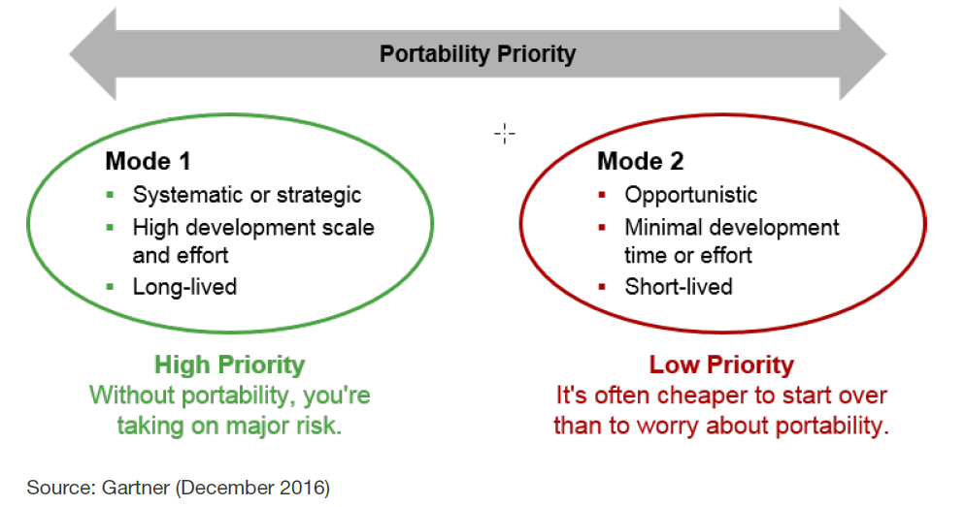
Prioritizing Portability Based on Application Characteristics
Mode 1 focuses on delivering reliability, while Mode 2 focuses on delivering agility.
Mode 1 employs strictly governed practices to shepherd sustaining technologies and process innovations that must remain stable over long periods of time.
By contrast, Mode 2 emphasizes results over processes, experimentation over stability, and disruptive innovation over the status quo.

